Slide 1

ScyMotive
Maria-Voice Intel
VOICE-FIRST AI FOR MISSION-CRITICAL OPERATIONS
Maria-Voice Intel
Real-time operations intelligence layer for factories, logistics, maritime and critical environments.
<2s voice target
Edge-ready
GDPR / RODO / EU AI Act
EU Data Residency
Role-Based Access
Audit Logs
PL / EN
10+ languages ready
Start with a 3-week pilot. Prove value. Deploy Maria V1.0.
01

Slide 2
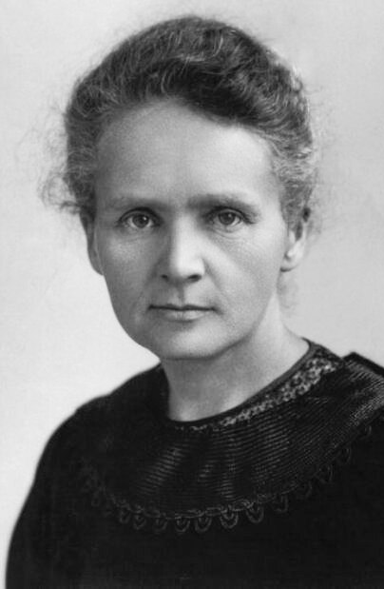
Maria Voice Intel
WHY MARIA
02
THE STORY BEHIND THE NAME
Inspired by Maria Skłodowska‑Curie.
Maria is named after a Polish-born scientist who became the first woman to win a Nobel Prize and the only woman to win two Nobel Prizes — in Physics and Chemistry.
“She turned invisible forces into discoveries that changed mankind.”
Curiosity
without fear
Science
For mankind
Resilience
under pressure
Maria‑Voice Intel carries the same principle into industry: make hidden operational knowledge instantly useful for the people running the plant.
Source: NobelPrize.org biography of Marie Curie.
ScyMotive HQ · Łódź, Poland | zeeshan@scymotive.com

Slide 3

ScyMotive
Maria-Voice Intel
THE OPERATIONAL GAP
Dashboards show data. Teams need answers.
When pressure hits, people lose time searching manuals, screens, messages and expert memory.
01
02
03
Critical know-how lives in people
Incidents demand speed
Downtime kills margin
When experts are absent or leave, operational continuity becomes fragile.
Operators need the right procedure and live context immediately.
Every minute of delay impacts productivity, delivery and customer trust.
02

Slide 4

ScyMotive
Maria-Voice Intel
WHAT MARIA DOES
Maria turns operational complexity into spoken guidance.
A voice interface connected to company knowledge, live data and operational workflows.
01
02
03
04
Voice question
Live context
Knowledge layer
Action answer
Operator asks naturally: “Why did line 3 slow down?”
Maria checks IoT / SCADA snapshots and APIs.
Maria retrieves SOPs, manuals and internal playbooks.
Maria responds with next-best action and escalation path.
Result: faster decisions, fewer delays, stronger operational resilience.
03

Slide 5

ScyMotive
Maria-Voice Intel
MANUFACTURING USE CASE
Voice intelligence for the factory floor.
Maria supports operators, maintenance teams and managers with live context and procedural knowledge.
“What is blocking the current line?”
Zero‑downtime mindset
Maria V1.0 Factory Deployment
“Show the next troubleshooting step.”
continuous operations
Built to scale across production lines, sites and teams once pilot value is proven.
“Escalate this to maintenance.”
Faster onboarding
“Which SOP applies here?”
less expert dependency
04

Slide 6






ScyMotive
Maria-Voice Intel
INDUSTRY APPLICATIONS
Designed for environments where time, trust and continuity matter.
Factories
Logistics & Fleets
Maritime & Shipping
Line support, downtime analysis, maintenance guidance.
Driver support, route incidents, vehicle checks and field guidance.
Crew support, technical procedures and low-connectivity operations.
Healthcare & Clinics
Cyber-Resilient Ops
Critical Infrastructure
Scheduling, notes, tasks and clinical workflow support.
Continuity during cyberattacks and degraded networks.
Incident response, checklists and expert knowledge access.
05

Slide 7

ScyMotive
Maria-Voice Intel
BUSINESS IMPACT
Maria is designed to maximise operational ROI.
The strongest business case is not “AI novelty” — it is continuity, productivity and protected know‑how.
↓ Downtime
↑ Productivity
No lost know‑how
Greater ROI
faster root cause support
less searching, faster execution
procedures retained and reused
continuous operations at scale
Next 5–10 years: companies with operational AI layers will scale faster in the age of AGI.
06

Slide 8
ScyMotive
Maria-Voice Intel
3-WEEK PILOT
Start small. Prove value fast. Deploy with confidence.
A focused pilot validates Maria in a real operational workflow before full V1.0 deployment.
Week 1
Week 1–2
Week 2–3
Final
Pain-point mapping
Data + knowledge connection
Voice prototype
ROI + roadmap
Select the workflow with highest measurable impact.
Connect selected SOPs, manuals, APIs or system snapshots.
Test real operational questions with the team.
Define business case and Maria V1.0 deployment plan.
NEXT: MARIA V1.0 FACTORY / ENTERPRISE DEPLOYMENT
07

Slide 9

ScyMotive
Maria-Voice Intel
TECHNOLOGY FOUNDATION
Secure, modular and deployment-ready.
Cloud, on-prem, hybrid or edge — depending on operational and cybersecurity requirements.
Voice layer
AI reasoning
Data layer
Security layer
Streaming STT + TTS
LLM + RAG
IoT / SCADA / APIs
RBAC + audit
Natural operator interaction
Answers grounded in company knowledge
Live operational context
Privacy, governance and control
EU-aligned deployment • On-prem option • Offline resilience • Operational auditability
08

Slide 10

ScyMotive
Maria-Voice Intel
NEXT STEP
Bring Maria into your operations.
Book an executive discovery session. We will identify the strongest pilot use case and define how Maria can create measurable value in your environment.
3-week pilot → Maria V1.0 deployment
Factories • Logistics • Maritime • Clinics • Critical Infrastructure
Natalia@scymotive.com
09

